Slide 1
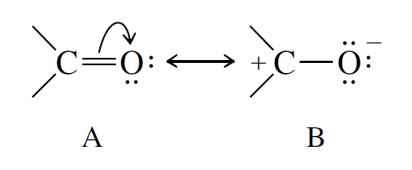
Exercícios propostos compostos carbonilados I

Slide 2
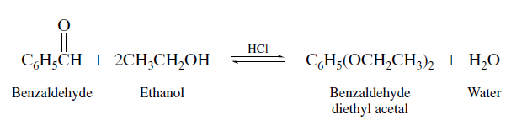
Exercícios sobre adição nucleofílica ao grupamento carbonila.
01- Write a stepwise mechanism for the formation of benzaldehyde diethyl acetal from benzaldehyde and ethanol under conditions of acid catalysis.
HCl is a strong acid and, when dissolved in ethanol, transfers a proton to ethanol to give ethyloxonium ion. Thus, we can represent the acid catalyst as the conjugate acid of ethanol. The first three steps correspond to acid-catalyzed addition of ethanol to the carbonyl group to yield a hemiacetal.

Slide 3
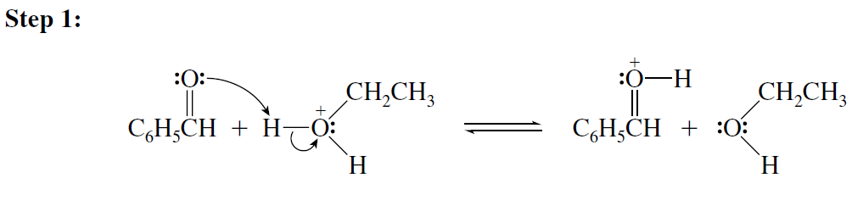
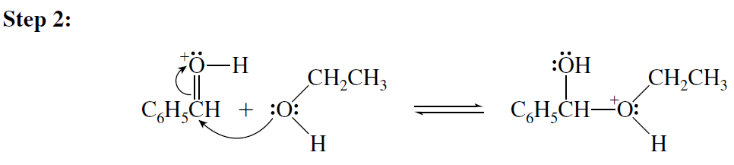
Exercícios sobre adição nucleofílica ao grupamento carbonila.
01- Write a stepwise mechanism for the formation of benzaldehyde diethyl acetal from benzaldehyde and ethanol under conditions of acid catalysis.

Slide 4
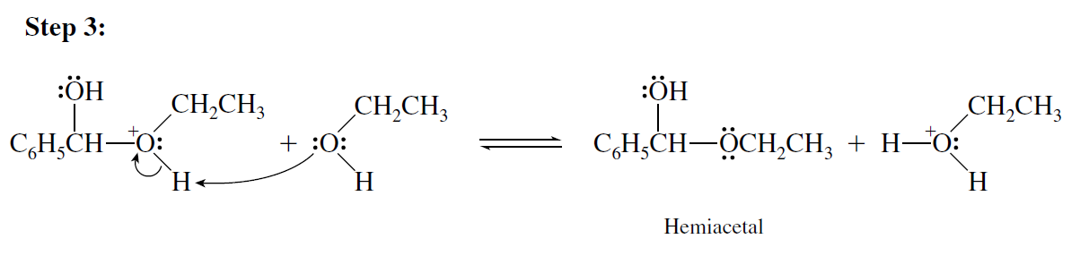
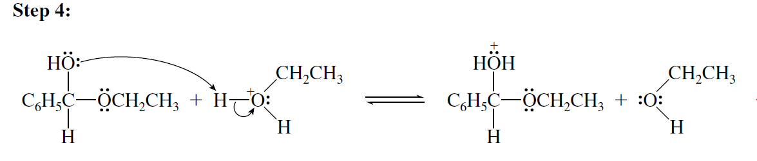
Exercícios sobre adição nucleofílica ao grupamento carbonila.
01- Write a stepwise mechanism for the formation of benzaldehyde diethyl acetal from benzaldehyde and ethanol under conditions of acid catalysis.
Formation of the hemiacetal is followed by loss of water to give a carbocation.

Slide 5
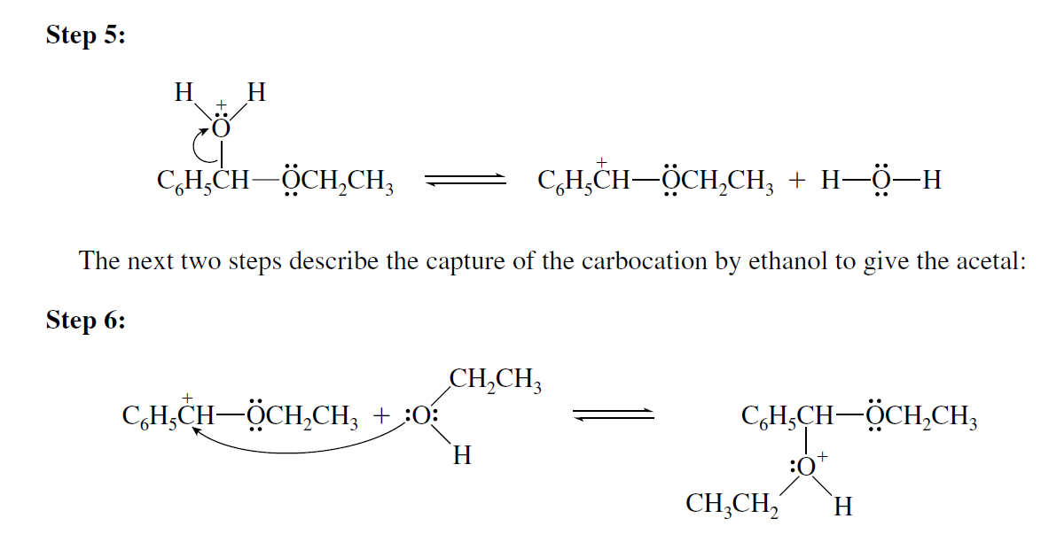
Exercícios sobre adição nucleofílica ao grupamento carbonila.
01- Write a stepwise mechanism for the formation of benzaldehyde diethyl acetal from benzaldehyde and ethanol under conditions of acid catalysis.

Slide 6
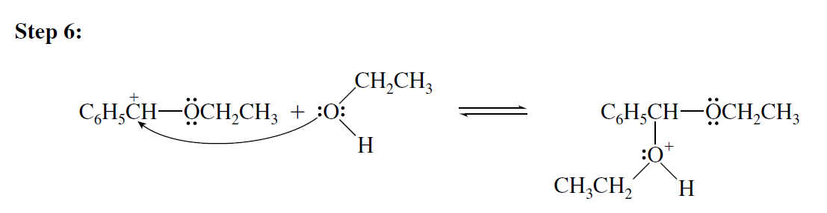
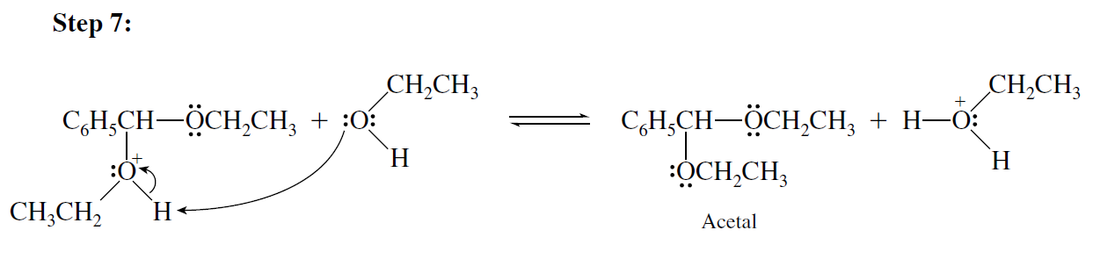
Exercícios sobre adição nucleofílica ao grupamento carbonila.
01- Write a stepwise mechanism for the formation of benzaldehyde diethyl acetal from benzaldehyde and ethanol under conditions of acid catalysis.

Slide 7
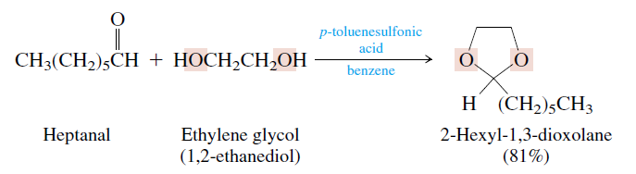
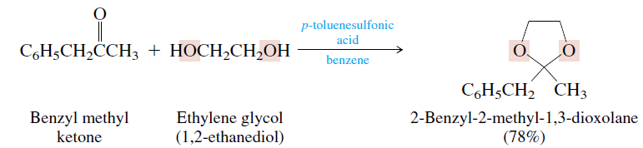
Exercícios sobre adição nucleofílica ao grupamento carbonila.
02- Write the overall reaction completing the reaction below:
?
?

Slide 8
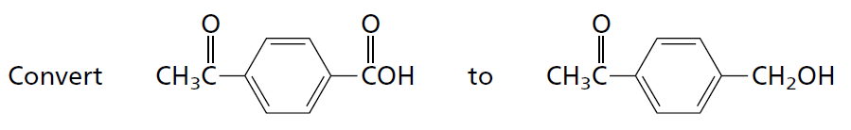
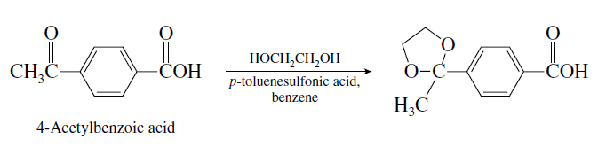
Exercícios sobre adição nucleofílica ao grupamento carbonila.
03- Acetal formation is a characteristic reaction of aldehydes and ketones, but not of carboxylic acids. Show how you could advantageously use a cyclic acetal protecting group in the following synthesis:
The conversion requires reduction; however, the conditions necessary (LiAlH4) would also reduce the ketone carbonyl. The ketone functionality is therefore protected as the cyclic acetal.

Slide 9
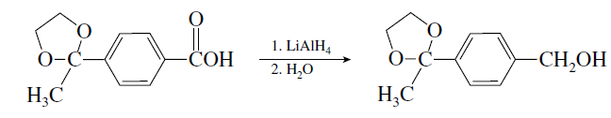
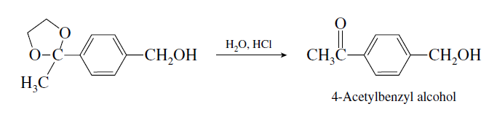
Exercícios sobre adição nucleofílica ao grupamento carbonila.

