Slide 1
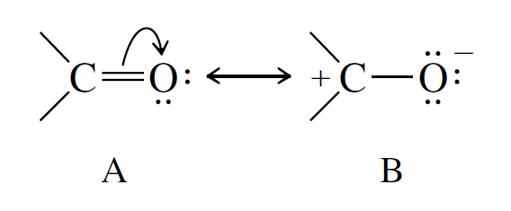
Exercícios propostos compostos carbonilados III

Slide 2
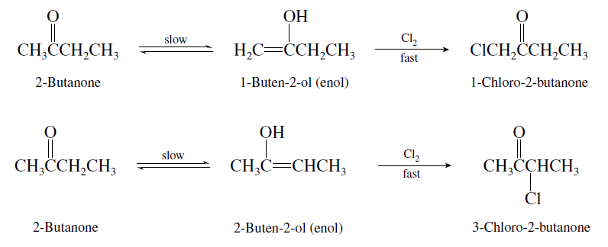
Exercícios sobre enolatos
01-Write the structures of the enol forms of 2-butanone that react with chlorine to give 1-chloro-2-butanone and 3-chloro-2-butanone.
The carbon–carbon double bond of the enol always involves the original carbonyl carbon and the α-carbon atom. 2-Butanone can form two different enols, each of which yields a different α-chloro ketone.

Slide 3
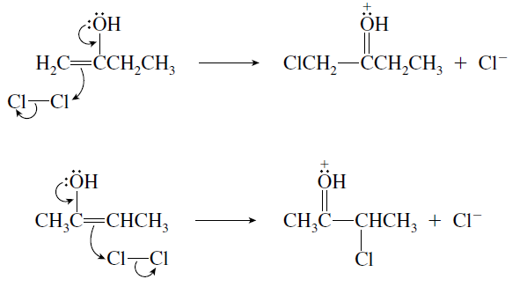
Exercícios sobre enolatos
02-Represent the mechanism reaction of chlorine with each of the enol forms of 2-butanone (see 01) according to the curved arrow formalism just described.
Chlorine attacks the carbon–carbon double bond of each enol.

Slide 4

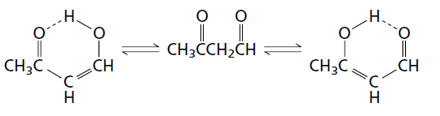
Exercícios sobre enolatos
03- Write structural formulas corresponding to
(a) The two most stable enol forms of
(b) The two most stable enol forms of 1-phenyl-1,3-butanedione.
(a) Enolization of this 1,3-dicarbonyl compound can involve either of the two carbonyl groups:
Both enols have their carbon–carbon double bonds conjugated to a carbonyl group and can form an intramolecular hydrogen bond. They are of comparable stability.

Slide 5
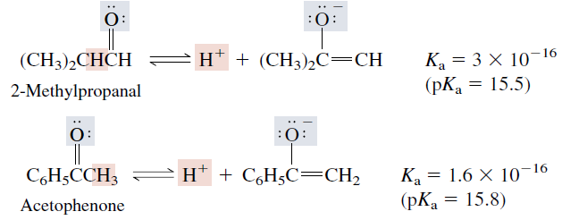
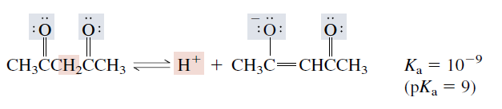
Exercícios sobre enolatos
04- Discuss the relatively acidic protons on their α-carbon atoms:

Slide 6
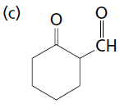
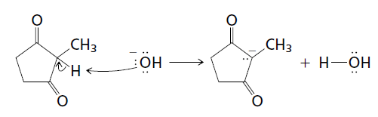
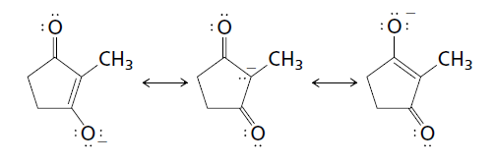
Exercícios sobre enolatos
05- Write the structure of the enolate ion derived from each of the following β-dicarbonyl compounds. Give the three most stable resonance forms of each enolate.
(a) 2-Methyl-1,3-cyclopentanedione
(b) 1-Phenyl-1,3-butanedione
(a) First identify the proton that is removed by the base. It is on the carbon between the two carbonyl groups.
The three most stable resonance forms of this anion are:

Slide 7
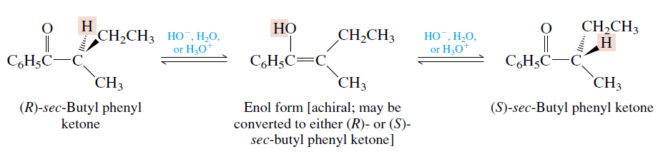
Exercícios sobre enolatos
06- Complete the following scheme. Would optically active ketones such as the following undergo acid- or base-catalyzed racemization? Explain your answer.
?
If the -carbon atom of an aldehyde or a ketone is a stereogenic center, its stereochemical integrity is lost on enolization. Enolization of optically active sec-butyl phenyl ketone leads to its racemization by way of the achiral enol form.

Slide 8
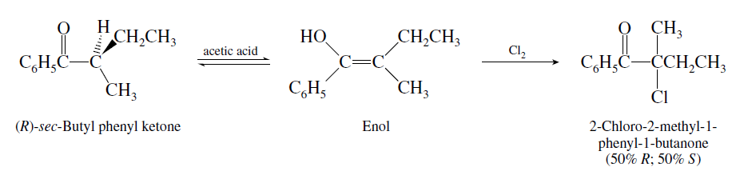
Exercícios sobre enolatos
07- Is the product from the chlorination of (R)-sec-butyl phenyl ketone with Cl2 in acetic acid chiral? Is it optically active?
α-Chlorination of (R)-sec-butyl phenyl ketone in acetic acid proceeds via the enol. The enol is achiral and yields equal amounts of (R)- and (S)-2-chloro-2-methyl-1-phenyl-1-butanone. The product is chiral. It is formed as a racemic mixture, however, and this mixture is not optically active.

Slide 9
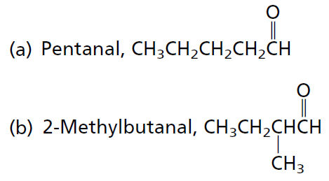
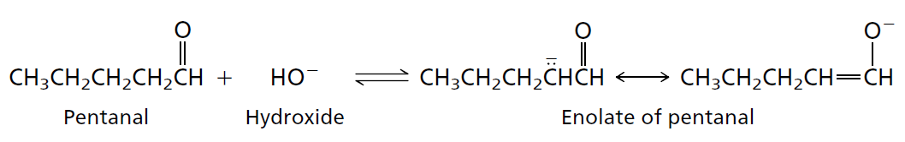
Exercícios sobre enolatos
08- Write the structure and the mechanism of the aldol addition product of:
(a) A good way to correctly identify the aldol addition product of any aldehyde is to work through the process mechanistically. Remember that the first step is enolate formation and that this must involve proton abstraction from the carbon.

Slide 10
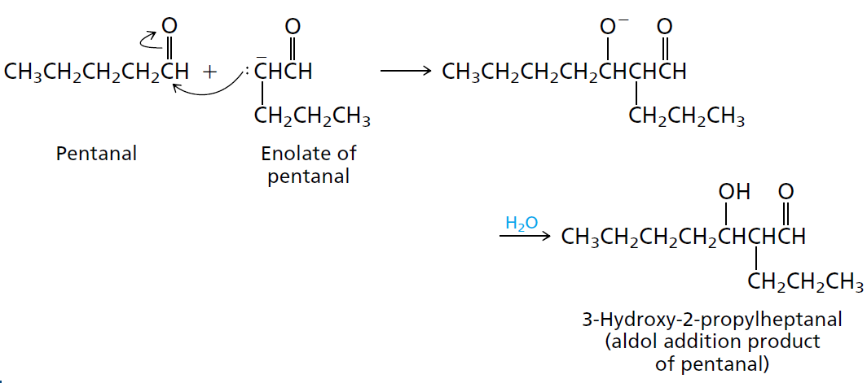
Exercícios sobre enolatos
08- Write the structure and the mechanism of the aldol addition product of:

Slide 11
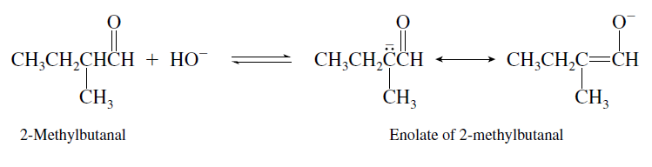
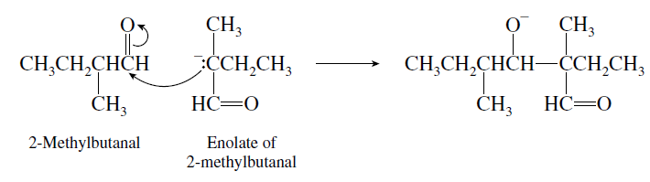
Exercícios sobre enolatos
08- Write the structure and the mechanism of the aldol addition product of:
(b) Approaching this problem mechanistically in the same way as part (a), write the structure of the enolate ion from 2-methylbutanal.
This enolate adds to the carbonyl group of the aldehyde.

Slide 12
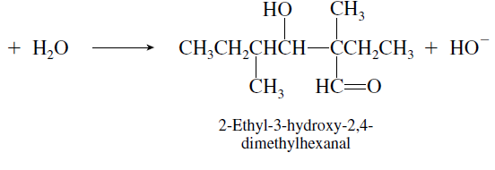
Exercícios sobre enolatos
08- Write the structure and the mechanism of the aldol addition product of:
A proton transfer from solvent yields the product of aldol addition.

Slide 13
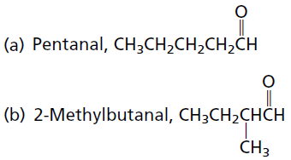
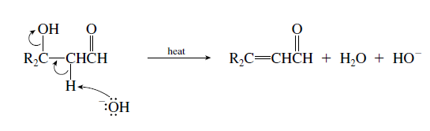
Exercícios sobre enolatos
09- Write the structure of the aldol condensation product of each of the folowing aldehydes . One of these aldehydes can undergo aldol addition, but not aldol condensation. Which one? Why?
Dehydration of the aldol addition product involves loss of a proton from the α-carbon atom and hydroxide from the β-carbon atom.

Slide 14
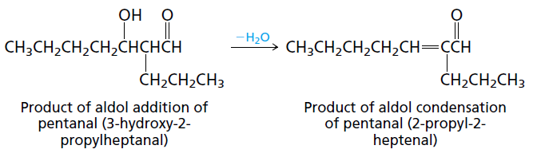
Exercícios sobre enolatos
09- Write the structure of the aldol condensation product of each of the folowing aldehydes . One of these aldehydes can undergo aldol addition, but not aldol condensation. Which one? Why?
(a) Dehydration of the product of aldol addition of pentanal introduces the double bond between C-2 and C-3 to give an α,β-unsaturated aldehyde.

Slide 15
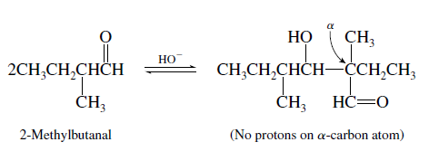
Exercícios sobre enolatos
09- Write the structure of the aldol condensation product of each of the folowing aldehydes . One of these aldehydes can undergo aldol addition, but not aldol condensation. Which one? Why?
(b) The product of aldol addition of 2 methylbutanal has no α hydrogens. It cannot dehydrate to an aldol condensation product

Slide 16
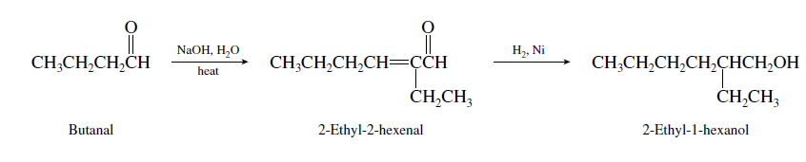
Exercícios sobre enolatos
10- Outline a synthesis of 2-ethyl-1-hexanol from butanal.
1 2 3 4 5 6
7 8
1 2 3 4
The carbon skeleton of 2-ethyl-1-hexanol is the same as that of the aldol condensation product derived from butanal. Hydrogenation of this compound under conditions in which both the carbon–carbon double bond and the carbonyl group are reduced gives 2-ethyl-1-hexanol.

